Slide 1
An Introduction to Metabolism
Chapter 8

Slide 2
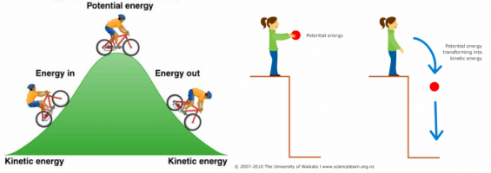
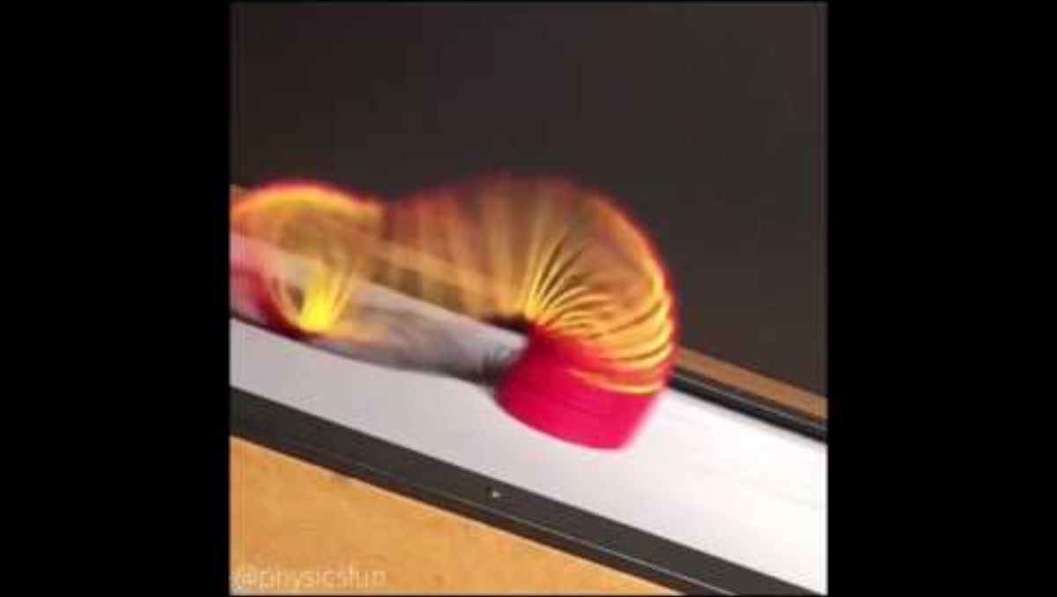
Converting energy

Slide 3
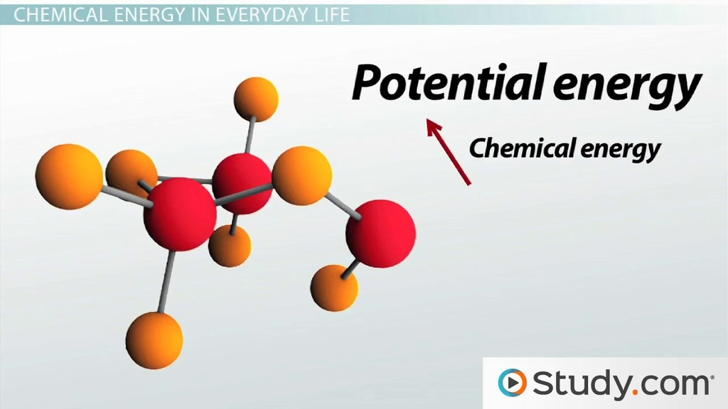
Chemical Energy

Slide 4
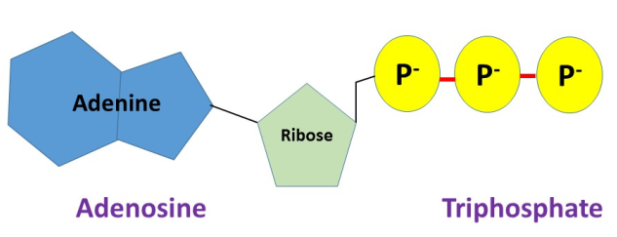
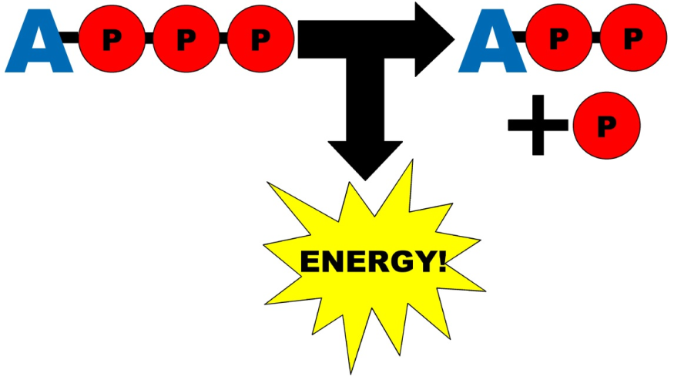
ATP: Energy currency of cells
Adenosine Triphosphate (ATP)
Hydrolysis of ATP releases energy
Bond between 2nd and 3rd phosphate is hydrolyzed
  Energy released
  Adenosine Diphosphate (ADP)
Released energy fuels cellular reactions

Slide 5
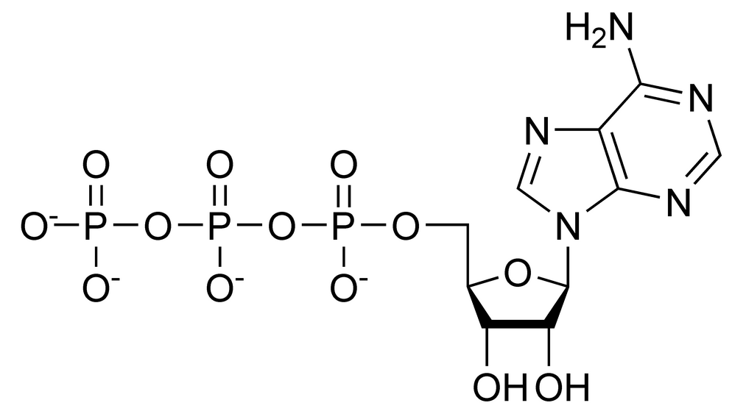
What is ATP?
A molecule made up of one adenosine (DNA/RNA nitrogenous base), ribose sugar (the sugar in RNA) and three phosphate functional groups
Phosphate groups are unstable
Removing the last one releases energy
  Hydrolysis reaction
  Makes ADP + energy
Reaction is reversible
ATP + H₂O ADP + P_{i} + energy

Slide 6

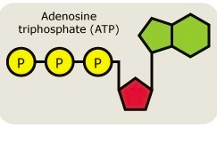



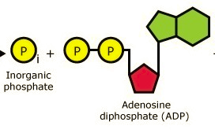


ATP
H₂O out
(Condensation)
H₂O in
(hydrolysis)
Energy in
Energy out
+
ADP

Slide 7
Metabolism
A cell is a chemical factory
All the reactions that a cell (or organism) makes to sustain life are called metabolism
Cells use the bonds in carbon and other molecules for energy

Slide 8
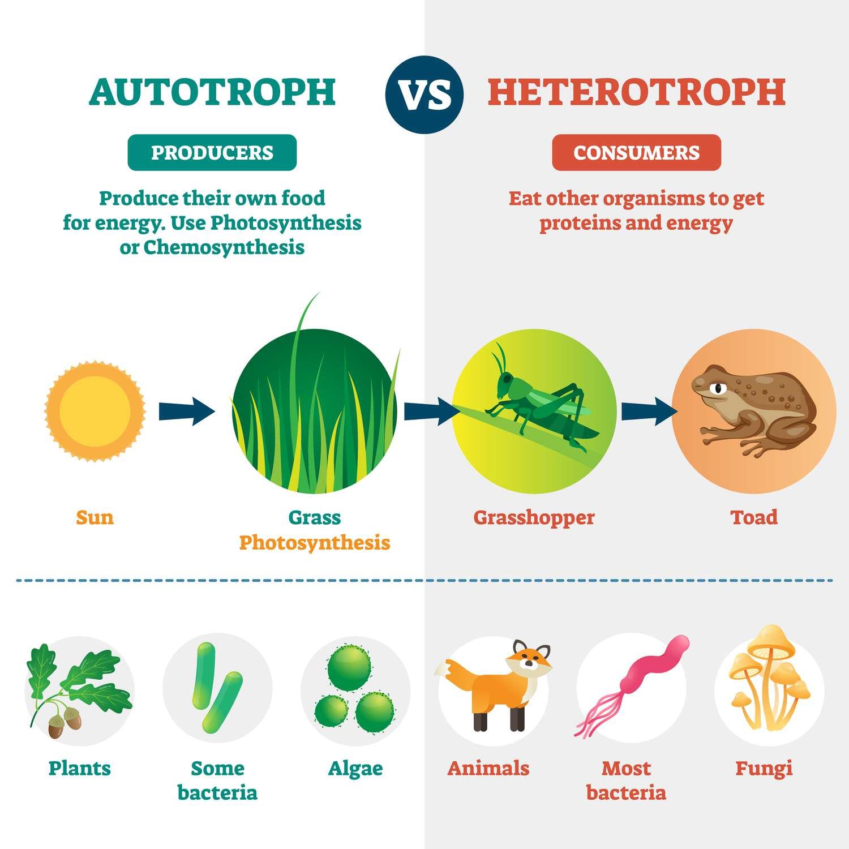
Metabolism
How cells obtain carbon depends on type of cell
Autotrophs
  “auto” – self
  “troph” – feed
  Plants, algae, some bacteria
Heterotrophs
  “hetero” – other, different
  “troph” – feed
  Eukaryotes
    animals
  Most bacteria

Slide 9
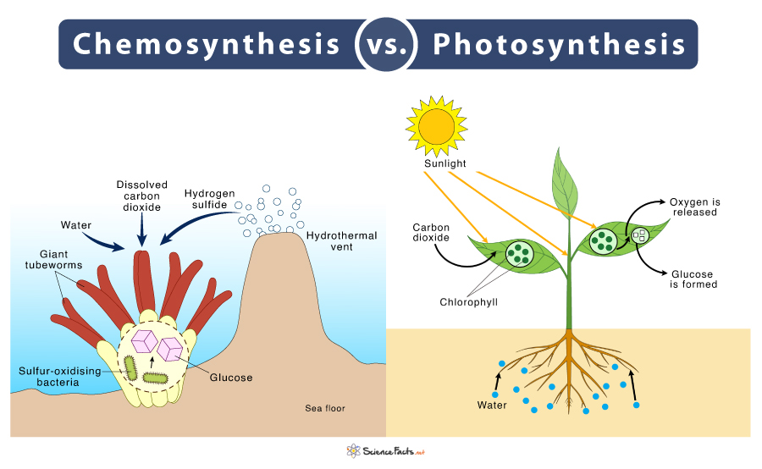
Autotrophs

Slide 10
Metabolism
Photoautotrophs
  Convert sunlight energy into G3P (a precursor to glucose)
Heterotrophs
  Hydrolyze ingested polymers of organic molecules into monomers
    Dinner of steak and potatoes
    Steak protein is hydrolyzed into individual amino acids
    Steak fat is hydrolyzed into different types of lipids.
    Potato carbohydrate is hydrolyzed to glucose monomers
Monomers can be further broken down to obtain energy or used to build new macromolecules.
The chemical energy in the bonds of polymers & monomers can be converted into ATP

Slide 11
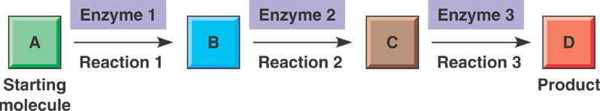
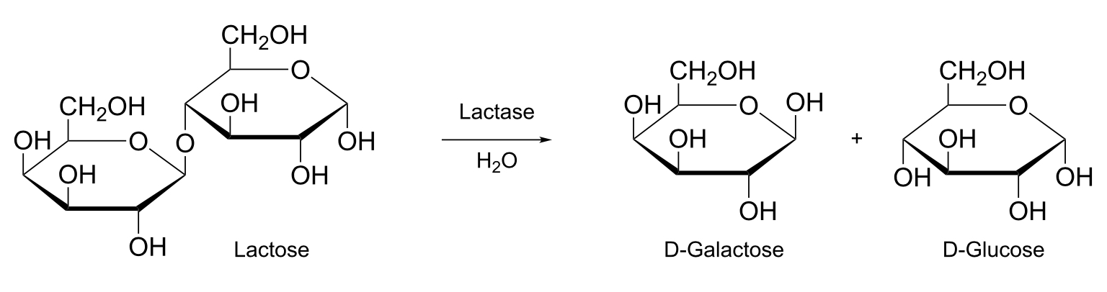
Metabolism
A metabolic pathway begins with a specific molecule (reactant) which is altered in a series of steps to result in a product(s)
Reactant

Slide 12
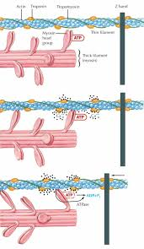
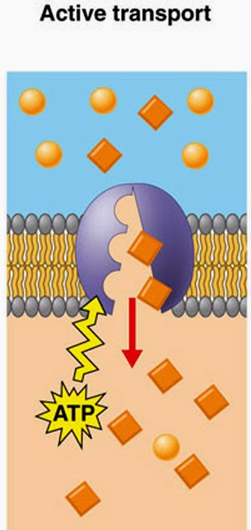
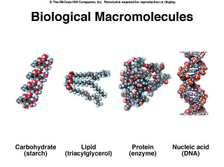
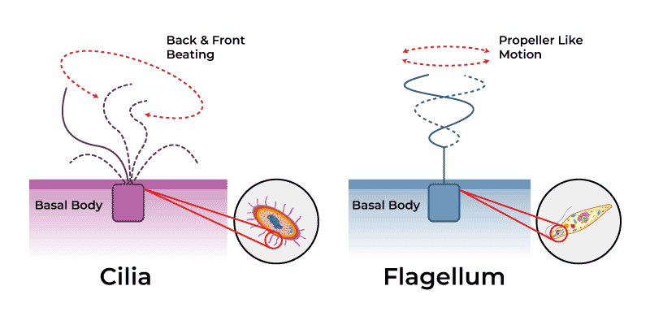
Cells and Energy
How do cells use energy? Some examples…
  Building proteins, carbohydrates, nucleic acids needed for life
  Transporting material into and out of the cell
  Muscle cells require energy to move
  Ciliated/Flagellated cells, need energy to fuel cilia/flagella

Slide 13
Cells and Energy
Gibbs Free Energy (G)
  The amount of free energy available to the cell to do work
  Energy created from breaking chemical bonds
  ΔG = change in free energy
    = G of products - G of reactants
  Determines whether a reaction is spontaneous or requires energy

Slide 14
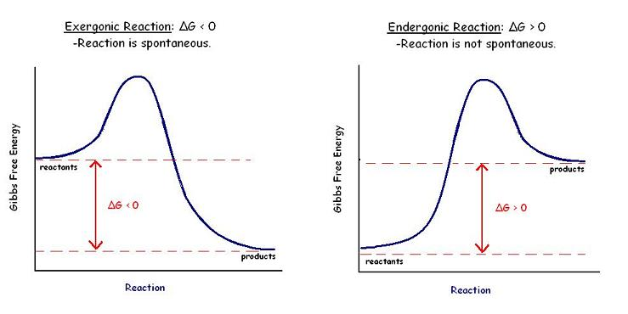
Gibbs Free Energy
  - ΔG reactions occur spontaneously
    Gives off energy
  + ΔG reactions require energy input
  Every reaction has a specific ΔG
    ΔG never changes!!
100kJ
100kJ
70 kJ
-70 kJ
30 kJ

Slide 15
Endergonic vs. Exergonic Reactions
All chemical reactions in the cell are coupled with ATP
  Some reactions require ATP
    Endergonic
      Endo – “in”
  Some reactions produce ATP
    Exergonic
      Exer – “out”
-70 kJ
70 kJ

Slide 16


Types of pathways
Anabolic pathway
  Synthesize
  Builds large molecules from smaller molecules
  Require energy
  +ΔG
  Endergonic
Catabolic pathway
  Degradative
  Breaks large molecules into smaller molecules
  Creates energy
  -ΔG
  Exergonic

Slide 17
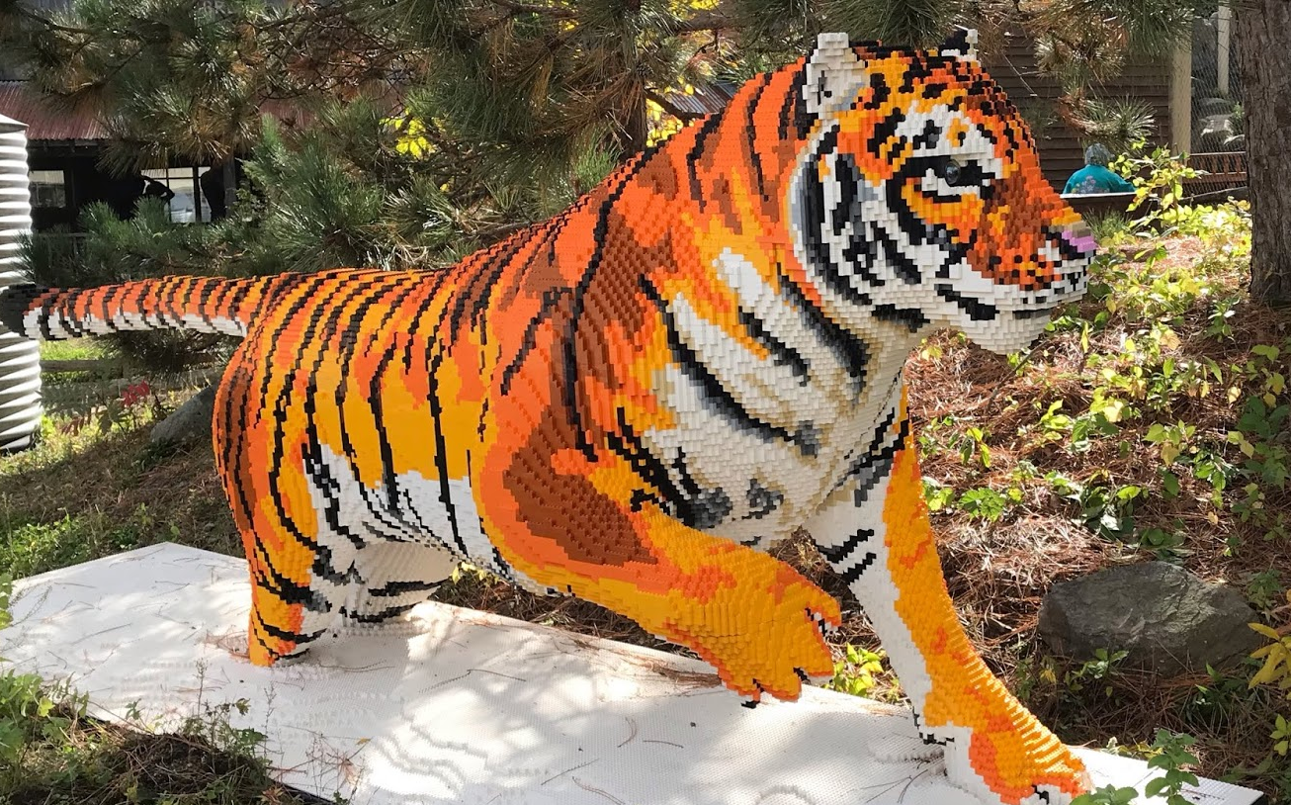
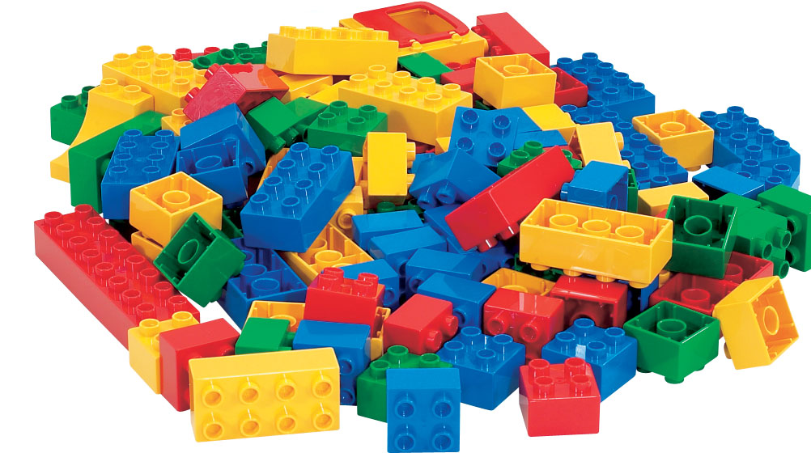
Reactant
Product

Slide 18
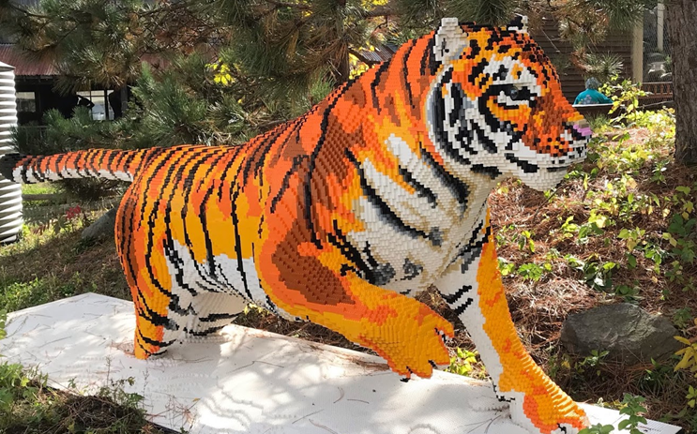
Product
Reactant

Slide 19
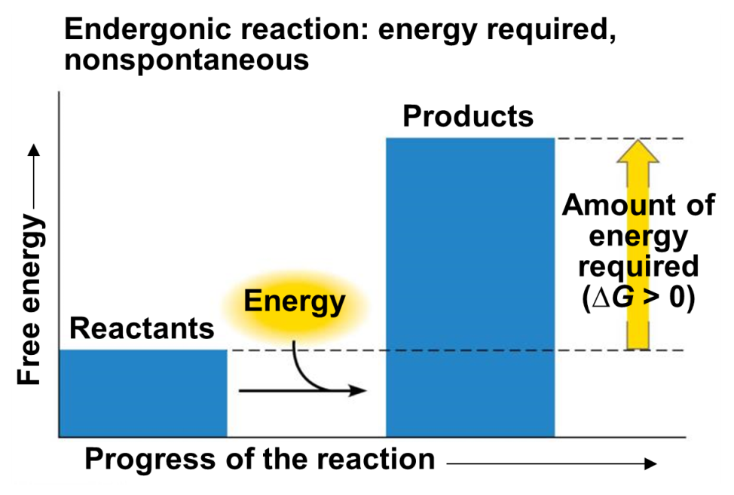
Endergonic Reactions
Endergonic Reactions (Anabolic)
  Uphill reaction
  Require energy payment of ATP
  +ΔG
  Products have more potential energy than reactants
Potential energy →

Slide 20
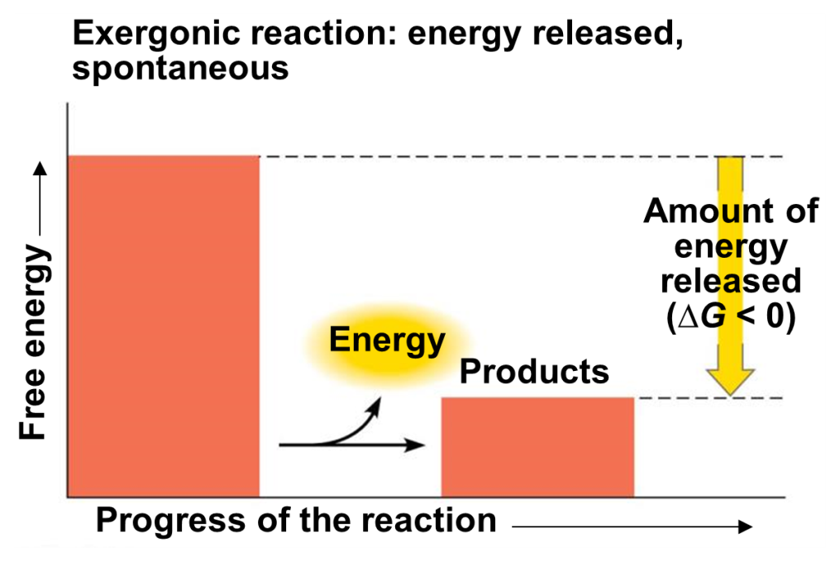
Exergonic Reactions
Exergonic Reactions
  Downhill (spontaneous)
  Produce energy in the form of ATP
  -ΔG
  Products have less potential energy than reactants
Potential energy →

Slide 21
Activation Energy Barrier
What prevents exergonic reactions from spiraling out of control???
Energy of Activation (E_{A})!!
Requires stress to be placed on the bonds to make them unstable
  Require energy to do this
  Even exergonic reactions require some small input of initial energy
This small input of initial energy is called Energy of Activation (E_{A})

Slide 22
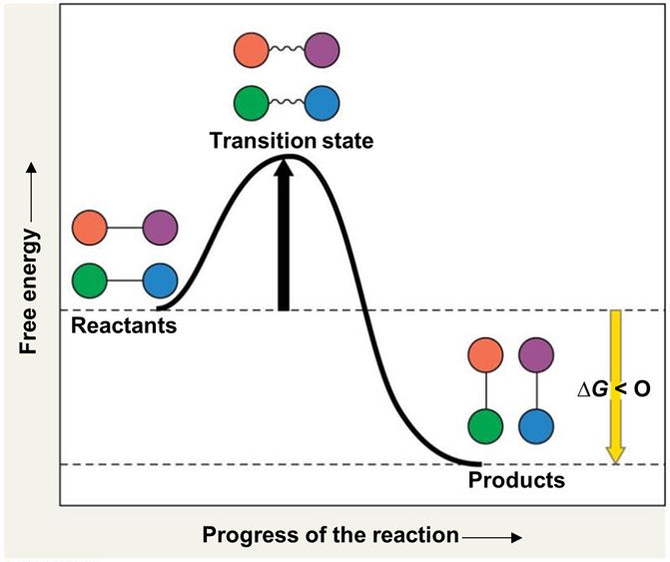
Energy of Activation

Slide 23
Enzymes Speed up Reactions
Enzymes are a type of protein that catalyze chemical reactions by lowering E_{A}
Enzymes do not make a reaction occur that would not normally occur
  Enzymes make a reaction occur quicker
Enzymes do not add energy to a reaction!
Enzymes do NOT change ΔG!!

Slide 24
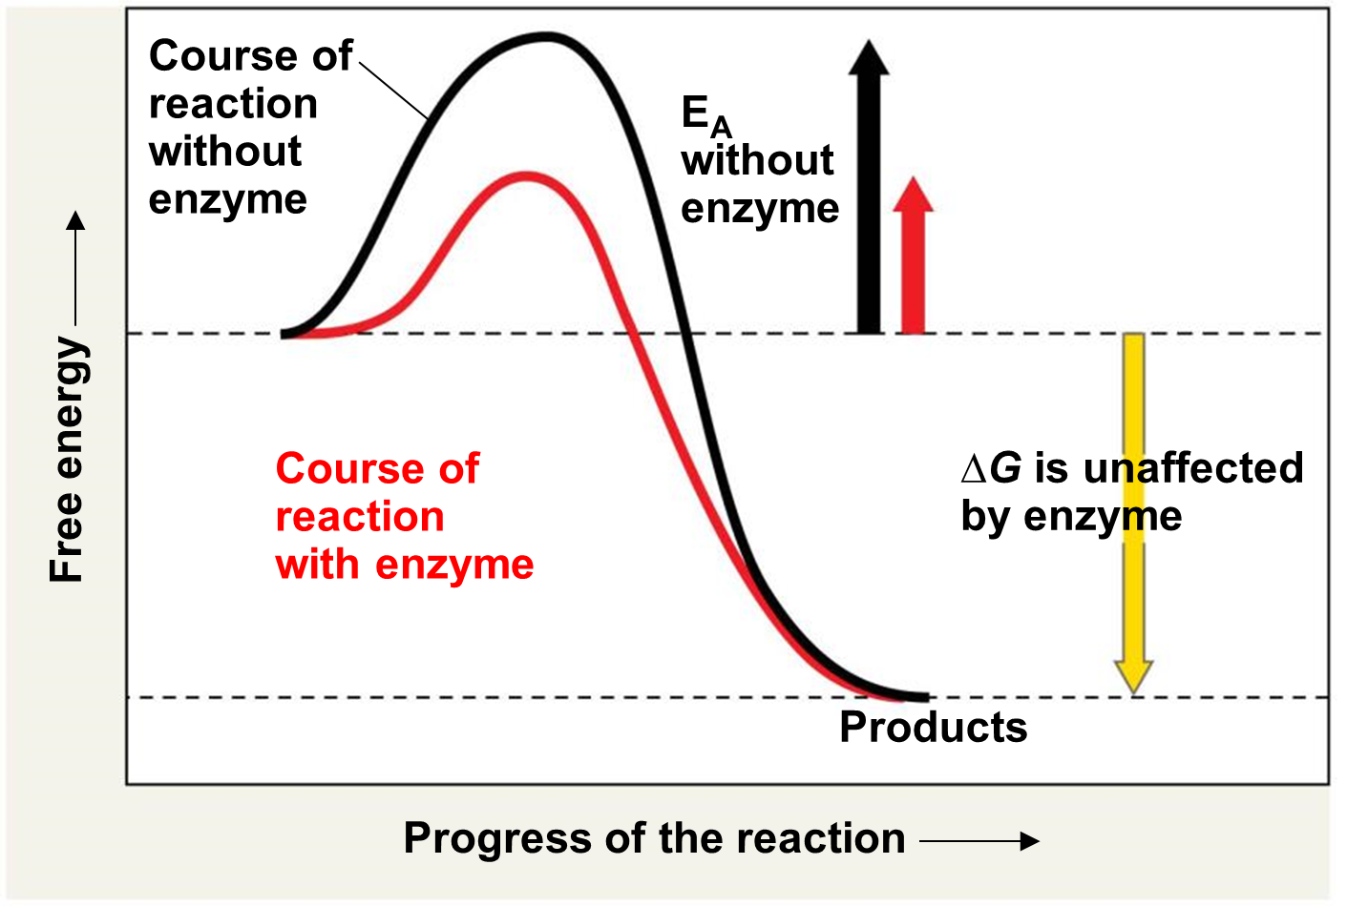

Slide 25
Practice…
For the reaction A → B, ΔG = +321
  Requires energy or gives off energy?
  Endergonic or exergonic?
  Catabolic or Anabolic?
If enzymes are added to the reaction A → B, what happens to ΔG? What is ΔG?

Slide 26
Practice
For the reaction S → T, ΔG = -125
  Requires energy or gives off energy?
  Endergonic or exergonic?
  Catabolic or Anabolic?
Could these reactions be coupled in a cell?

Slide 27
Coupled Reactions
Could these reactions be coupled in a cell?
A → B, ΔG = +321(endergonic, anabolic)
S → T, ΔG = -125 (exergonic, catabolic)
Coupled: A + S → B +T
ΔG_{net} = ΔG_{rxn1 +} ΔG_{rxn2}
ΔG_{net} = 321 + (-125)= 196 (overall requires energy)
Need ΔG_{net} to be negative (overall spontaneous reaction and favorable)

Slide 28
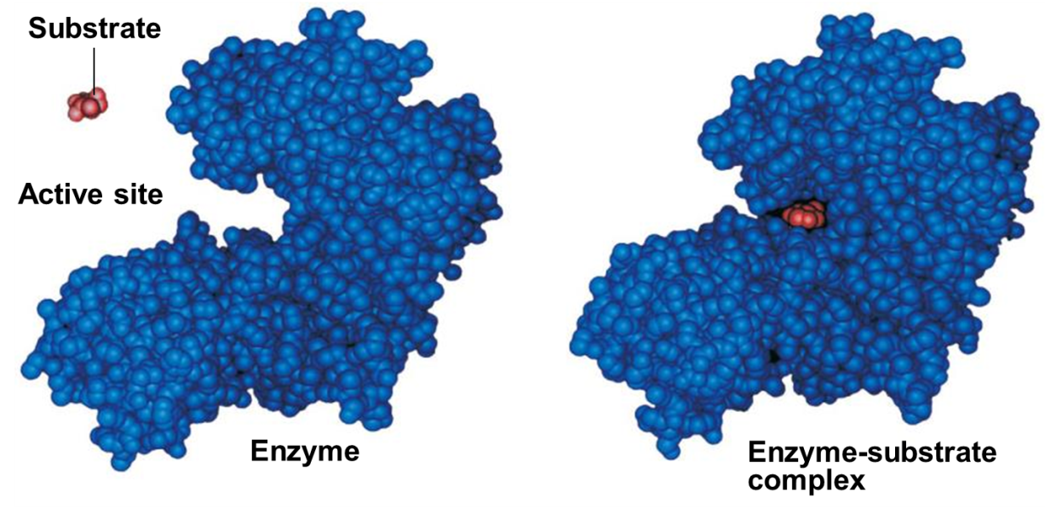
Enzyme Specificity
Enzymes bind to specific substrates (reactants)
  Binding takes place at the active site
    Lock and Key model
  Enzyme-Substrate Complex
Enzyme converts substrate to different product
  Enzyme is unchanged and is not consumed
    Can be used thousand, millions of times
  Substrate is changed

Slide 29
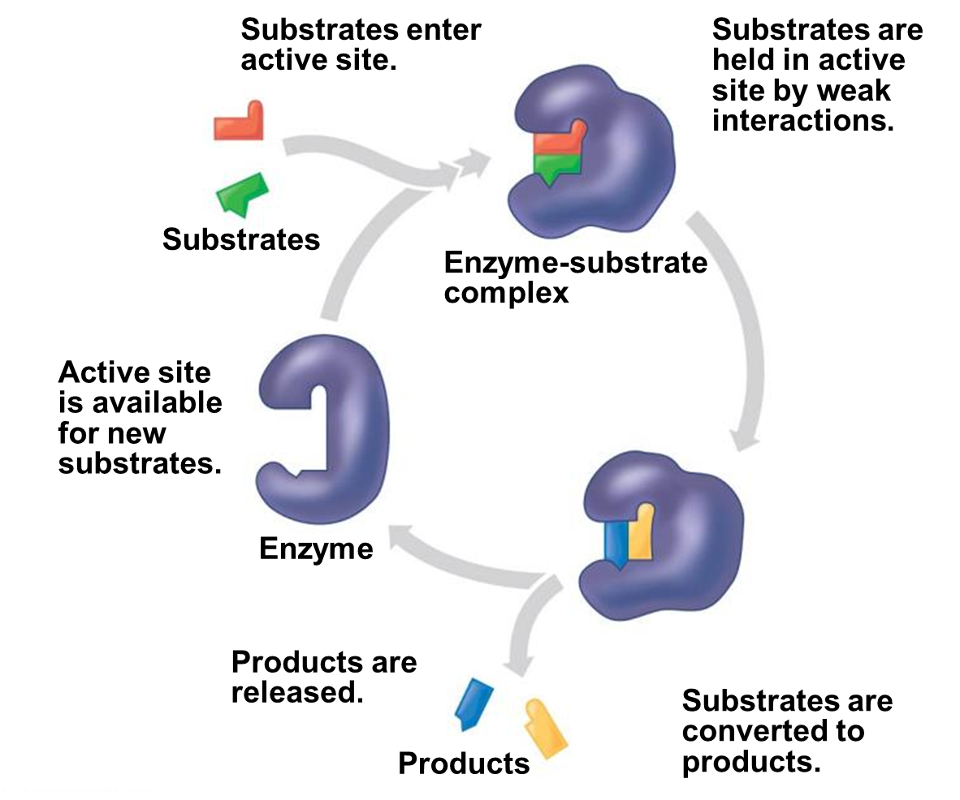

Slide 30
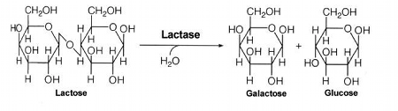
Enzymatic Reaction
Substrate on left (reactant)
Enzyme is “arrow”
  Enzymes end with “ase”
Products on the right

Slide 31
Enzyme Function
Enzymes are proteins
They are affected by temperature, pH, salt concentration, and inhibitors
High temp, acidic/basic pH will denature enzyme structure
  Changes shape of the active site
  Enzyme cannot bind to substrate anymore
  Rate of enzymatic activity decreases
Each enzyme has optimal temperature and pH
Consider organisms that live in arctic vs organisms that live in hydrothermal vents

Slide 32
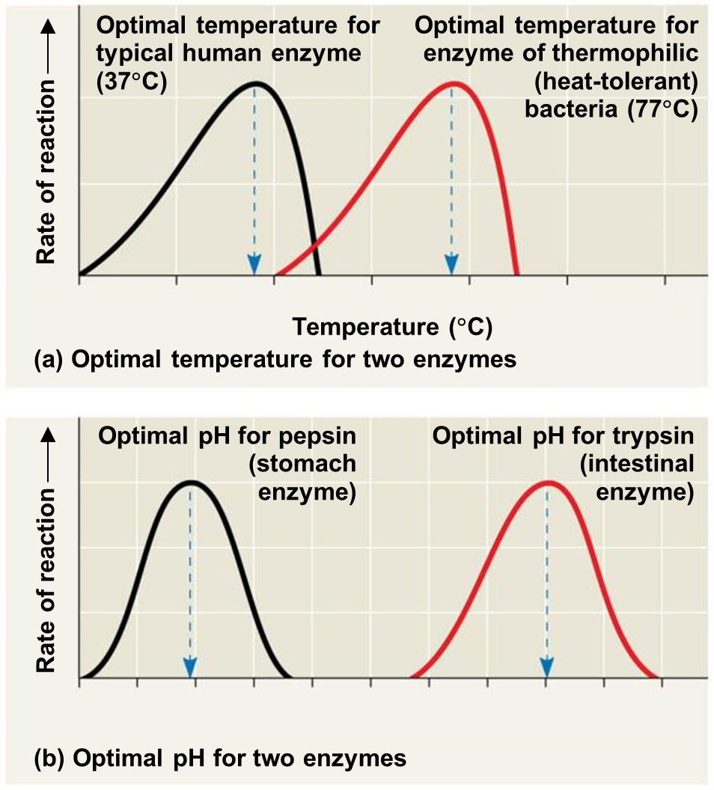

Slide 33
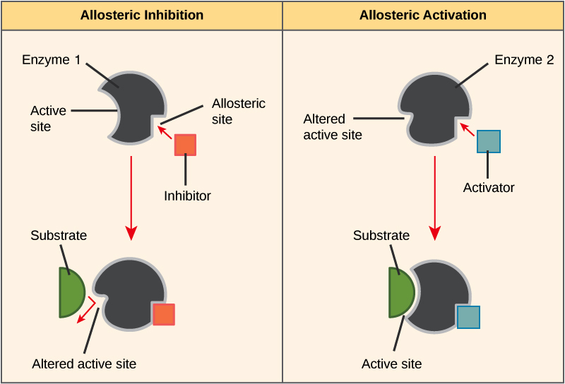
Enzyme Activation
Activators help enzymes
  Cofactors
    Vitamins are cofactors

Slide 34
Enzyme Inhibitors
Inhibitors block enzymatic activity
  Noncompetitive inhibitors
    Bind to enzyme at site remote from active site (Allosteric Site)
    Alters shape of active site
      Prevents substrate from binding

Slide 35
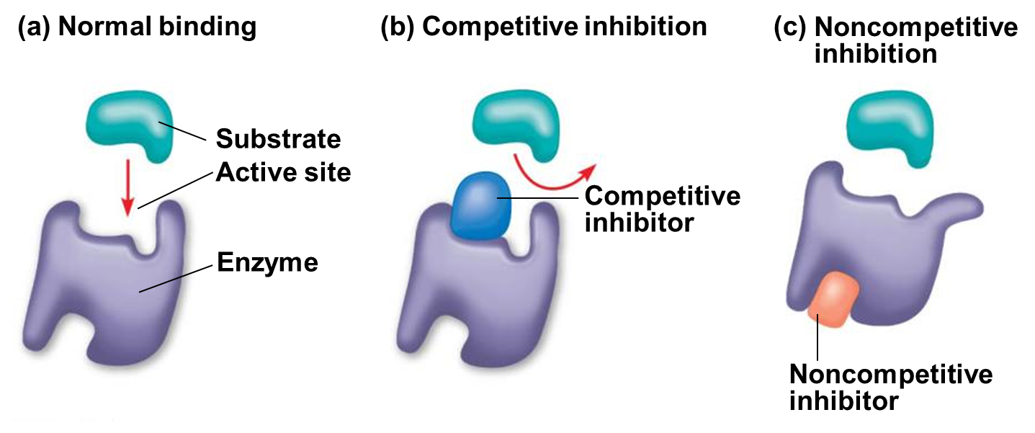
  Competitive inhibitors
    Mimic shape of substrate
    Bind to active site and block it
    Pharmaceutical applications
      Antibiotics, cancer treatment

Slide 36
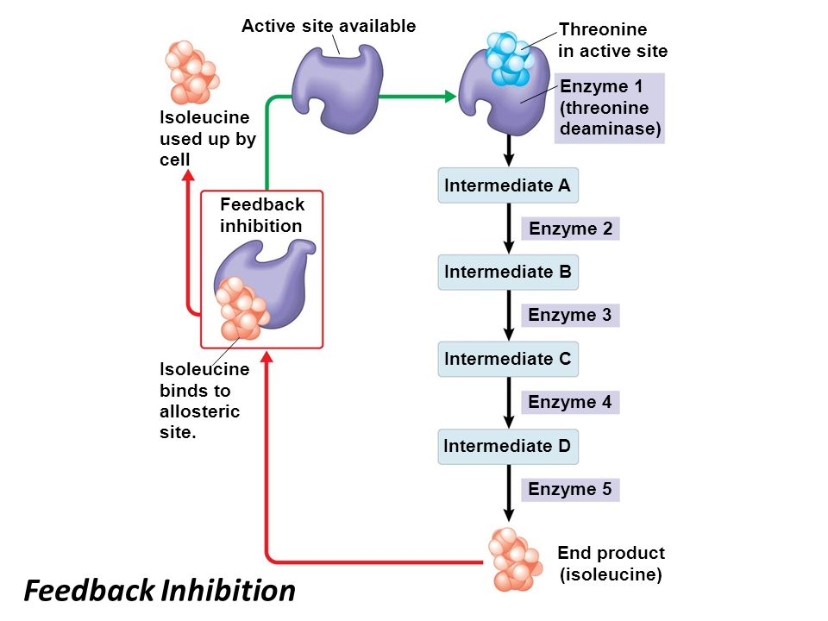
Feedback inhibition
Type of enzymatic regulation
Product acts as a noncompetitive inhibitor

